Slide 1
Informatics for Energy and Environment Policy
Energy Analytics

Slide 2
Energy Conservation
For every kwh of energy saved, there is a saving of the ‘would have been released’ carbon emission (in CO2 tonnes)

Slide 3
Our Role
As policy makers, we can use informatics to carry out energy analytics
Notes:
Like any other field, big data is available due to smart metering. As each individual’s energy consumption is now meticulously being monitored, that data is a gold mine. By using either data analysis techniques or machine learning model, suggestions or predictions can be made that could save millions

Slide 4
Energy Analytics Role
Energy Analytics can be used to:
Benchmark
Find anomalies
Finding patterns to make policies
Notes:
I will be discussing caveats and pitfalls of data analysis, visualization, and machine learning techniques in energy, in my report

Slide 5
Project Scope
Using a utility company’s data to make policy suggestions by:
Employing data analysis techniques
Preprocessing energy data
Visualizing in Python
Unsupervised machine learning (K means clustering) and/or Regression Modeling (Energy vs Time)
Notes:
Unsupervised learning is a type of machine learning that looks for previously undetected patterns in a data set with no pre-existing labels and with a minimum of human supervision. In contrast to supervised learning that usually makes use of human-labeled data, unsupervised learning, also known as self-organization allows for modeling of probability densities over inputs.^{[1]}
Cluster analysis is a branch of machine learning that groups the data that has not been labelled, classified or categorized.
Instead of responding to feedback, cluster analysis identifies commonalities in the data and reacts based on the presence or absence of such commonalities in each new piece of data. This approach helps detect anomalous data points that do not fit into either group.

Slide 6
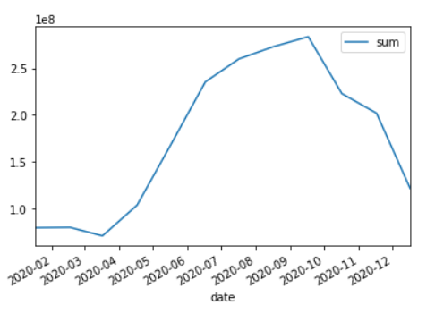
Visualizing time series
Notes:
and also Regressing energy consumption with time.
Time series analysis is ever more important in energy given its nature; in order to get electricity 24/7 a lot of planning goes into it and rtos need to painstakingly balance the equation of demand and supply. Given the inclusion of renewables that post or are happen to be capable of pitching in electricity to the grid amorphously, it becomes important to ascertain the demand pattern to better approximate the demand in the future which will allow us to prepare appropriately in advance.

Slide 7
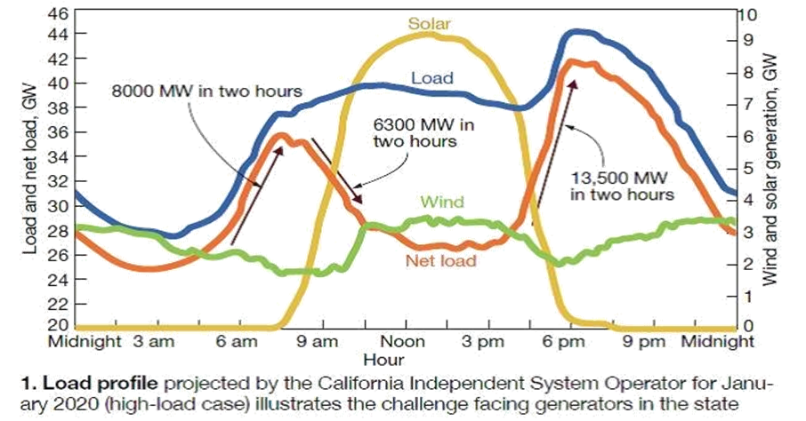
Use of informatics in Energy – The Duck Curve
https://www.energy.gov/eere/articles/confronting-duck-curve-how-address-over-generation-solar-energy

Slide 8
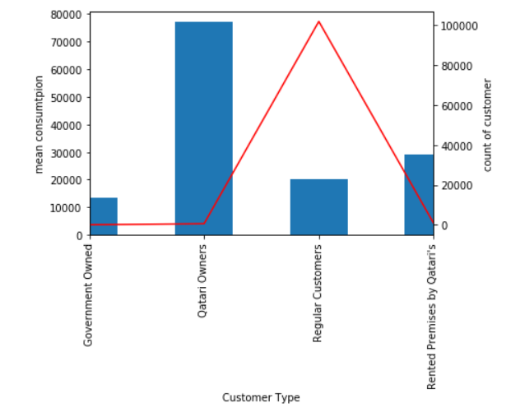
Finding Anomalies – Data Analysis
Notes:
The reason why I selected this topic is because there is a trend in the research industry. Intellectuals like us have grown a proclivity to research over ways to enhance efficiencies and amp up energy production. But when it comes to energy conservation, we turn a blind eye. So this idea revolves around energy conservation which then addresses multiple conundrums; be it environmental issues, or distribution losses. So what are multi grids:

Slide 9
Finding Anomalies – Kmeans Clustering
https://towardsdatascience.com/clustering-electricity-profiles-with-k-means-42d6d0644d00

Slide 10
__________END___________
Notes:
The motive here is to not go into technicalities but to get acquainted with the topic; realize its indispensable nature. Although smart grids and multi grids are essentially same but the reason I use the word Micro-grids is to not confuse you with the technology that makes them smart but I want you to grasp the idea which is the objective of the writers of this paper

